Slide 1


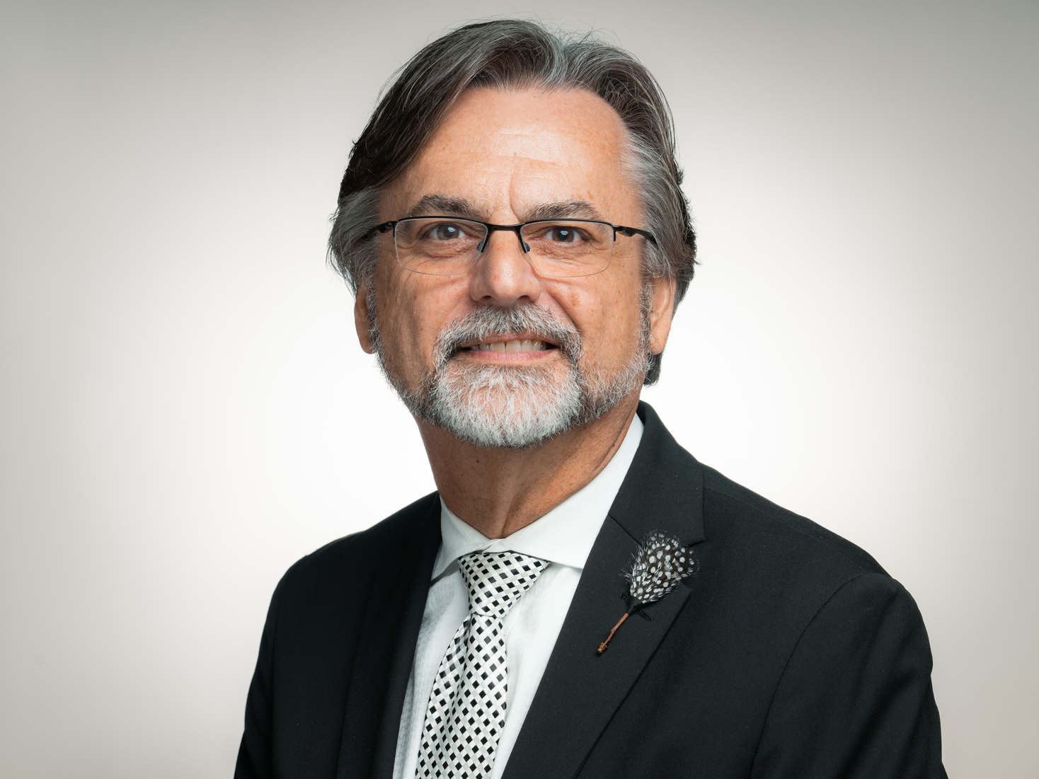
GREAT LAKES MINISTRIES
Regional Convention
June 25-27, 2027
New Location:
Indiana Wesleyan University
4201 S. Washington St.
Marion, IN 46953
Dr. Tim Harper
Regional Bishop
John 14:12
Very truly I tell you, whoever believes in me will do the works I have been doing, and they will do even greater things than these, because I am going to the Father.
Visit Our Website for more information
www.greatlakesregioncogop.org

Slide 2
GREAT LAKES MINISTRIES
Regional Convention
June 25-27, 2027
New Location:
Indiana Wesleyan University
4201 S. Washington St.
Marion, IN 46953
Dr. Tim Harper
Regional Bishop
John 14:12
Very truly I tell you, whoever believes in me will do the works I have been doing, and they will do even greater things than these, because I am going to the Father.
Visit Our Website
www.greatlakesregioncogop.org

Slide 3



Great Lakes Ministries
Regional Convention
2027
Indiana Wesleyan University
4201 S. Washington St.
Marion, IN 46953
June 25-27, 2027
On campus housing and hotel information
Available on our website.
www.greatlakesregioncogop.org

Slide 4

Great Lakes Ministries
Regional Convention
2027
Indiana Wesleyan University
4201 S. Washington St.
Marion, IN 46953
June 25-27, 2027
On campus housing and hotel information
Available on our website.
www.greatlakesregioncogop.org

Slide 5
Great Lakes Ministries
Regional Convention
2027
Meal Package #1
5 Meals:
Dinner Friday Evening
Breakfast Saturday Morning
Lunch Saturday Afternoon
Dinner Saturday Evening
Breakfast Sunday Morning
Nourishing Connections
ADULTS
$43 per person
for 5 meals
Meal Package #1
CHILDREN
$35 per person
for 5 meals
.
katiemealplan@gmail.com

Slide 6
Great Lakes Ministries
Regional Convention
2027
Meal Package #2
3 Meals:
Breakfast Saturday Morning
Lunch Saturday Afternoon
Dinner Saturday Evening
Nourishing Connections
ADULTS
$27 per person
for 3 meals
Meal Package #2
CHILDREN
$22 per person
for 3 meals
.
www.greatlakesregioncogop.org

Slide 7
GREAT LAKES MINISTRIES
Regional Convention
June 25-27, 2027
New Location:
Indiana Wesleyan University
4201 S. Washington St.
Marion, IN 46953
Dr. Tim Harper
Regional Bishop
John 14:12
Very truly I tell you, whoever believes in me will do the works I have been doing, and they will do even greater things than these, because I am going to the Father.
Visit Our Website
www.greatlakesregioncogop.org

