Slide 1


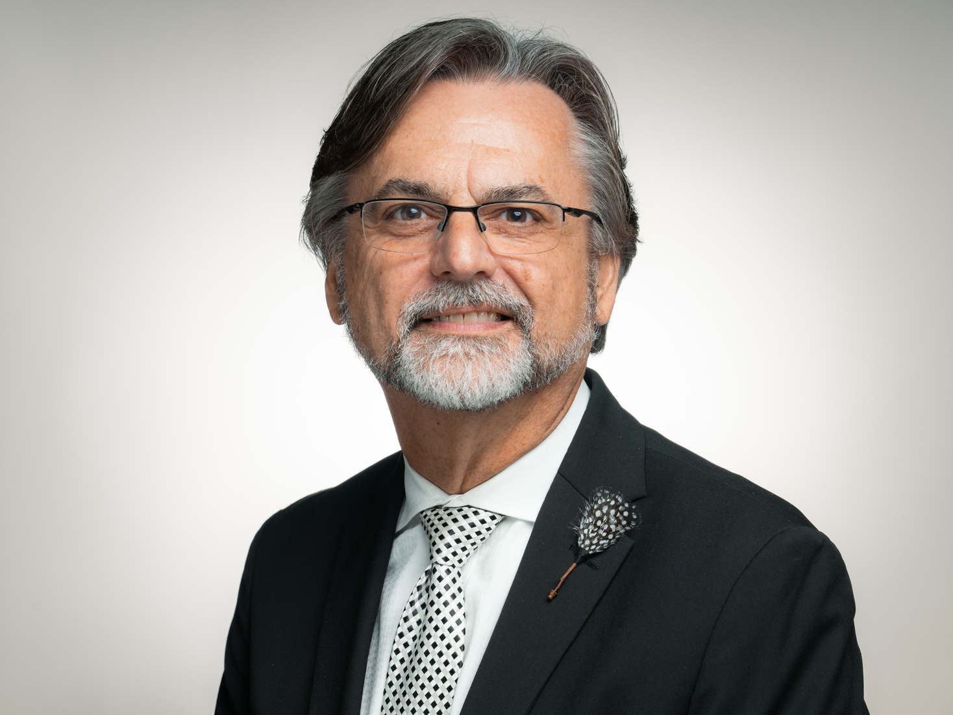
GREAT LAKES MINISTRIES
Regional Convention
June 25-27, 2027
New Location:
Indiana Wesleyan University
4201 S. Washington St.
Marion, IN 46953
Dr. Tim Harper
Regional Bishop
John 14:12
Very truly I tell you, whoever believes in me will do the works I have been doing, and they will do even greater things than these, because I am going to the Father.
Visit Our Website for more information
www.greatlakesregioncogop.org

Slide 2
GREAT LAKES MINISTRIES
Regional Convention
June 25-27, 2027
New Location:
Indiana Wesleyan University
4201 S. Washington St.
Marion, IN 46953
Dr. Tim Harper
Regional Bishop
John 14:12
Very truly I tell you, whoever believes in me will do the works I have been doing, and they will do even greater things than these, because I am going to the Father.
Visit Our Website
www.greatlakesregioncogop.org

